Slide 1
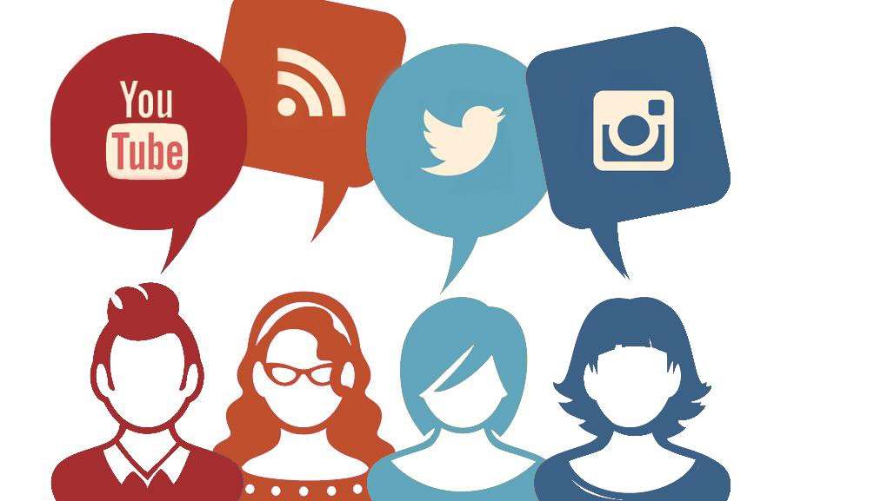
Influencer System
By Aryan Sharma and Thiru Venkat

Slide 2

Introduction
With social media apps dominating such a huge part of our eyes advertisers flock in masses to get the opportunity to show their product to us and they will keep finding new ways to do so and this quite often seems to clash with the field of social media and their influencers.
Apps like Instagram have a billion users who use it monthly and Facebook has over 2.8 billion users monthly.
The lockdown has served well for tech companies and influencers alike with a
80 % increase in social media usage due to the lockdown

Slide 3


The Issue…
There are new social media platforms which keep popping up and with that a new brand of influencers.
How long an app remains socially relevant depends on the types of influencers it has and for influencers to remain on their app they need advertisers to reach out to them

Slide 4
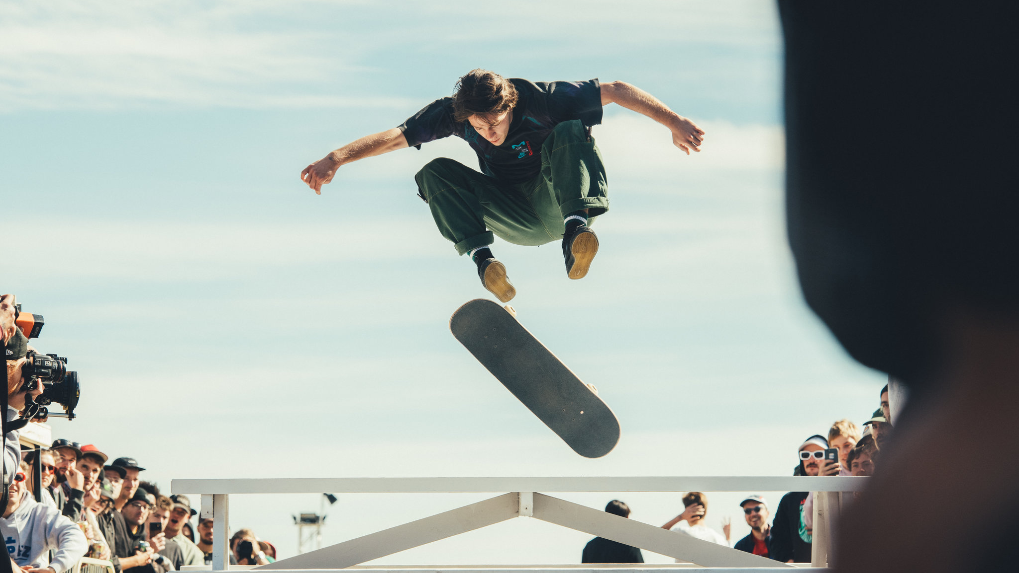
Our Solution
We plan to target apps like MOJ where it is harder for influencers to reach out to advertisers , there are many nascent social media apps which fail to use their influencers and when the social media app fails to retain their influencers, they tend to lose them. This slowly kills the app so we plan on building a platform which focuses on nascent apps which are early in building a strong base and hence by moving in early we have the first-mover advantage and will retain a high market share on up-and-coming influencers

Slide 5
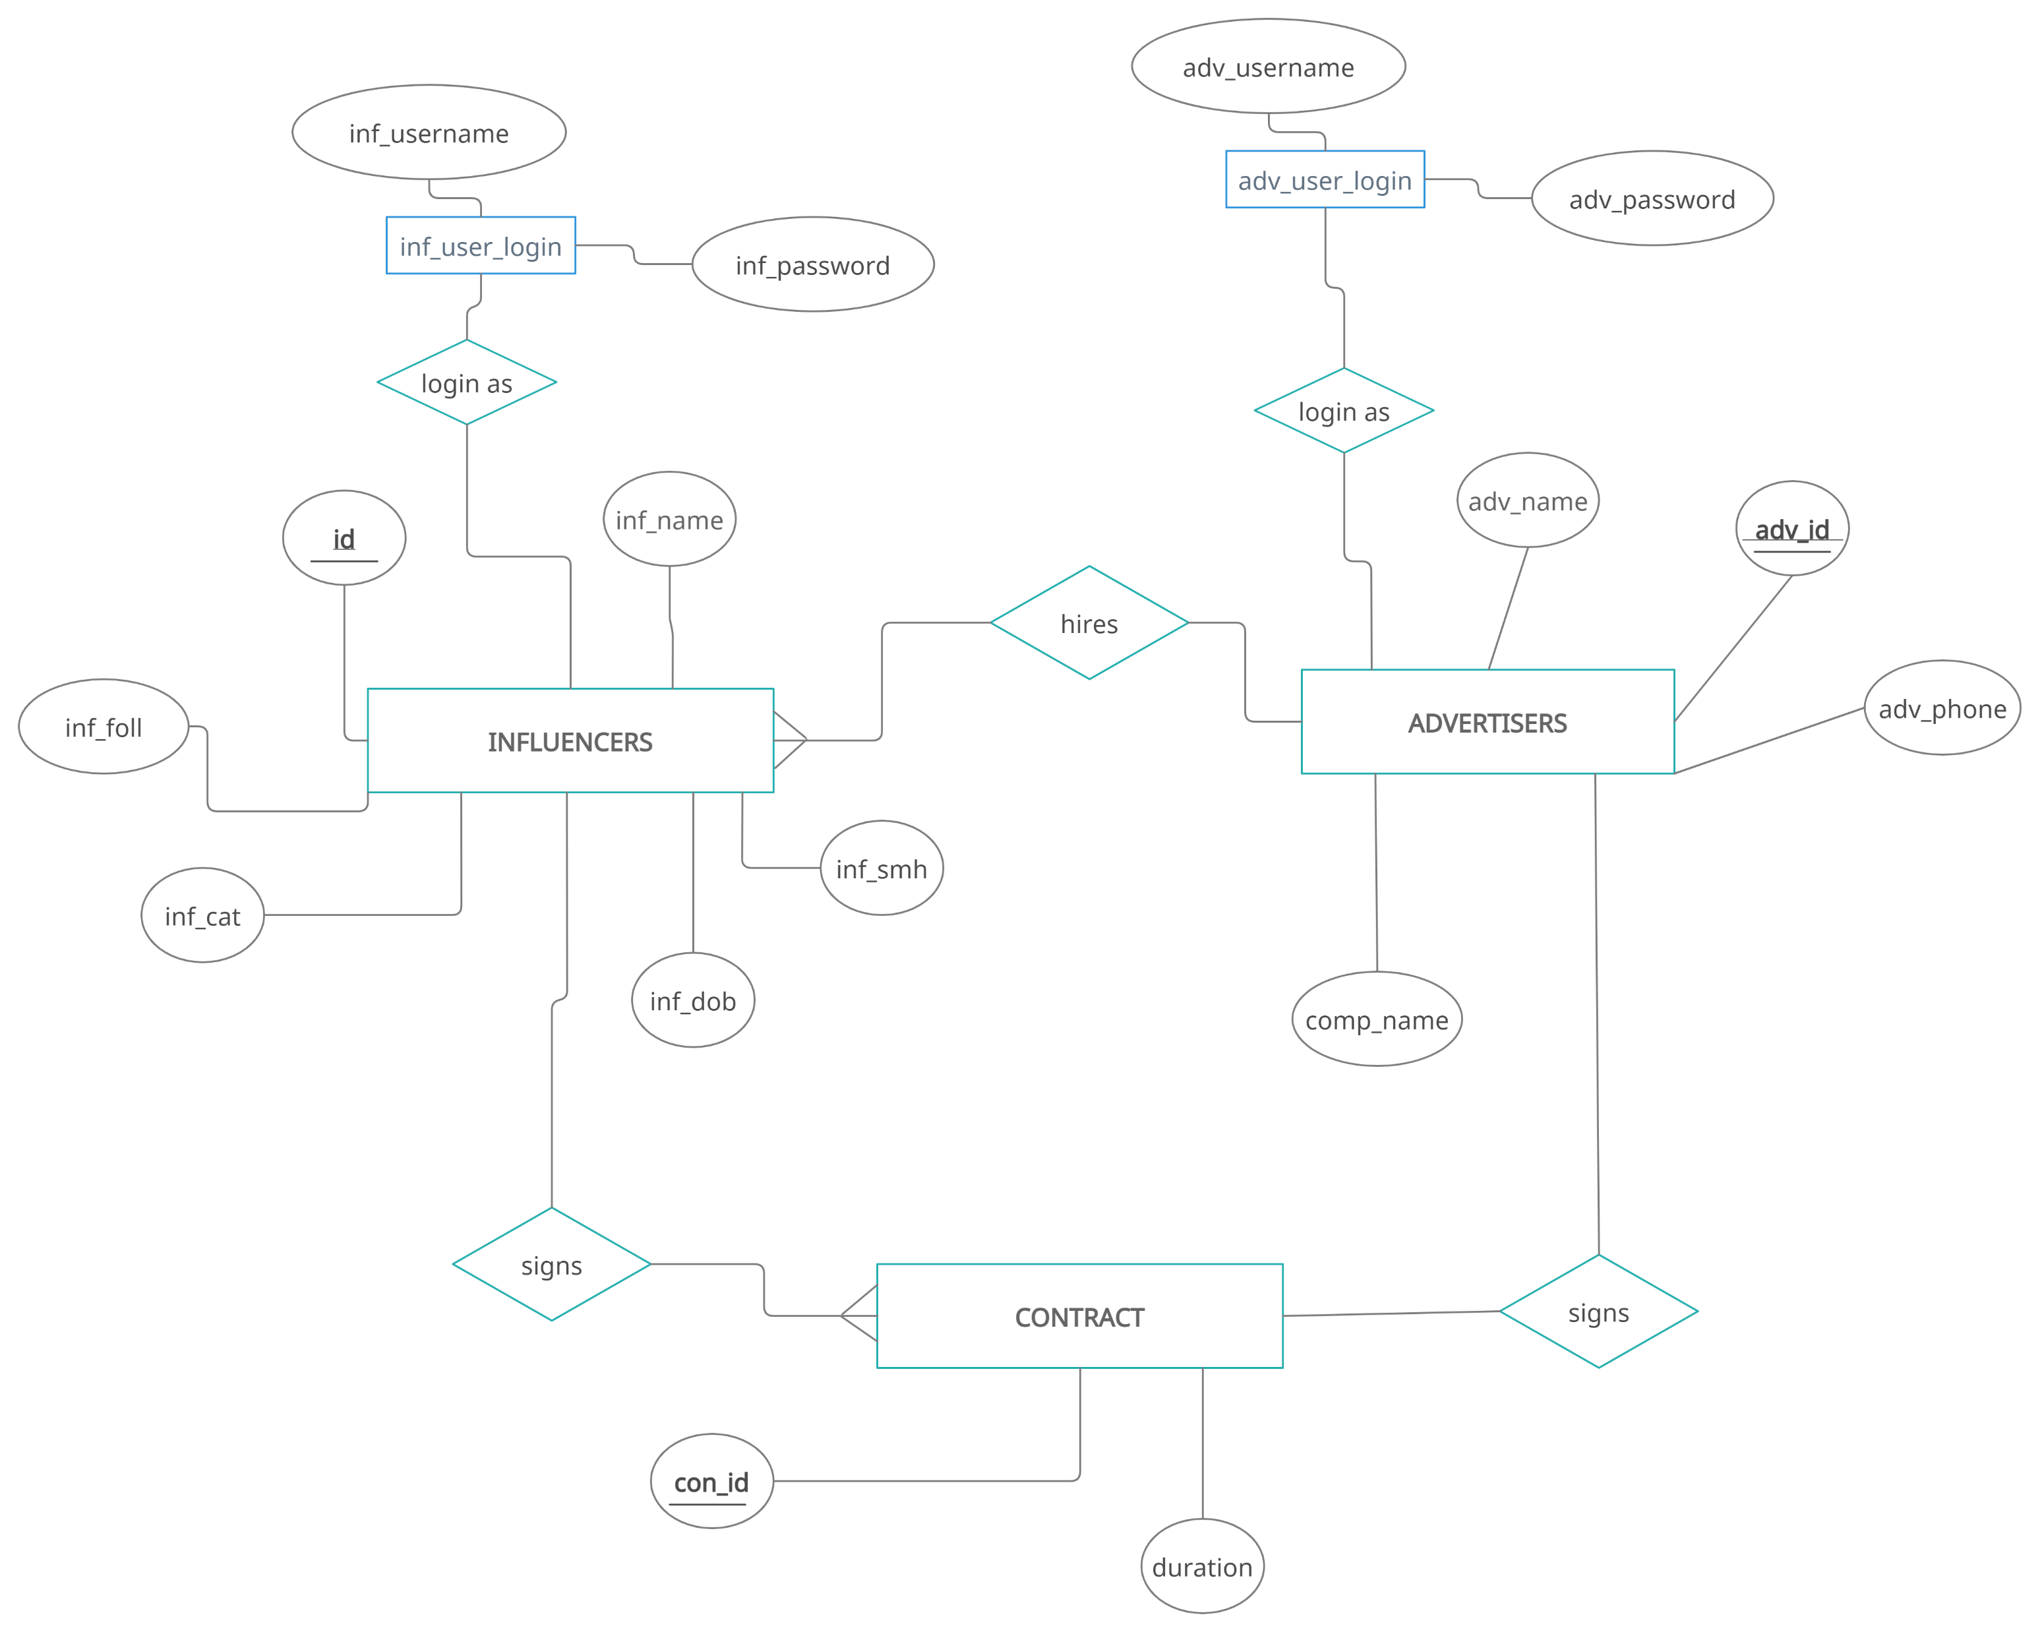
ER-Diagram

Slide 6
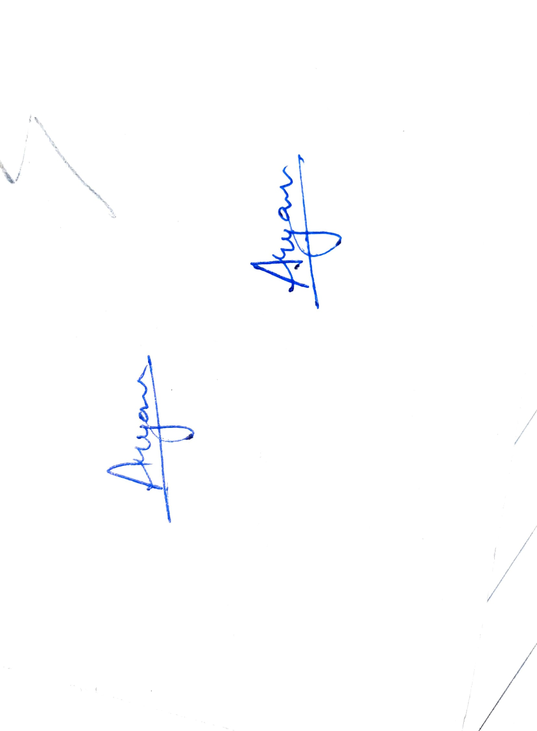
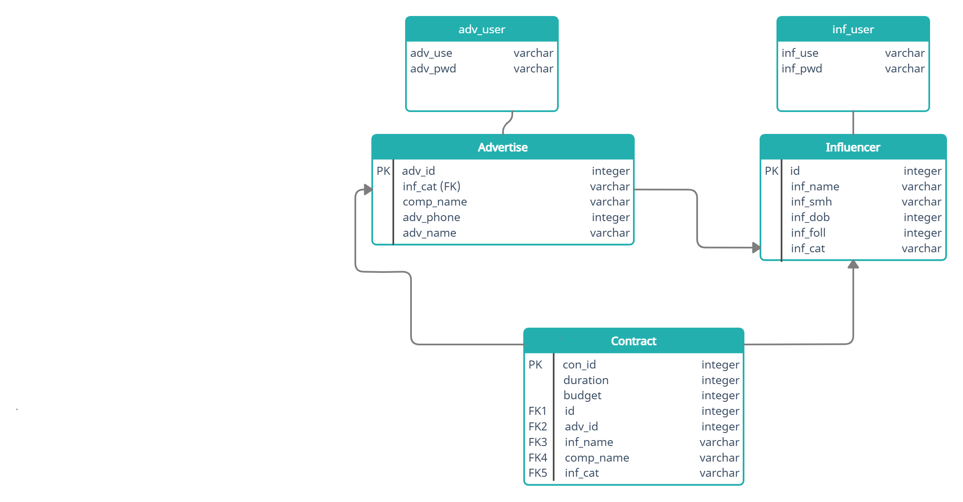
SCHEMA DIAGRAM

Slide 7
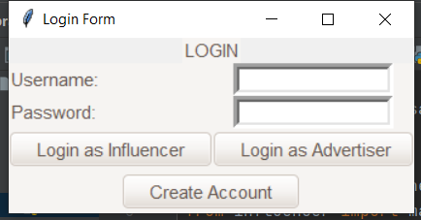
SCREENSHOTS

Slide 8
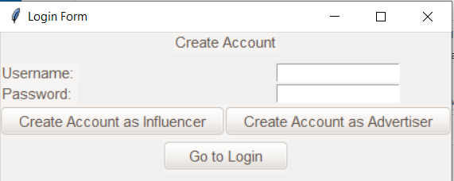

Slide 9
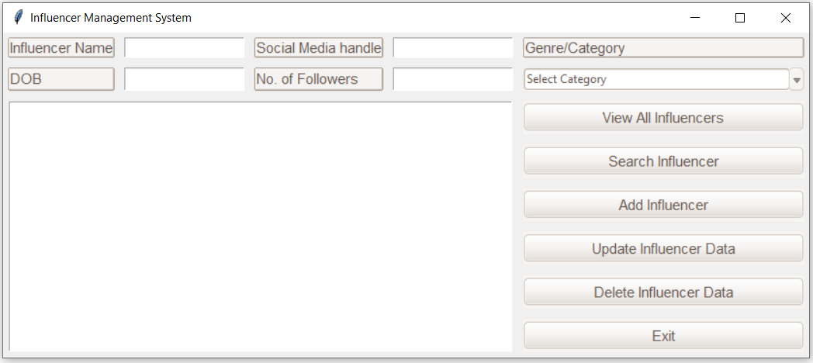

Slide 10
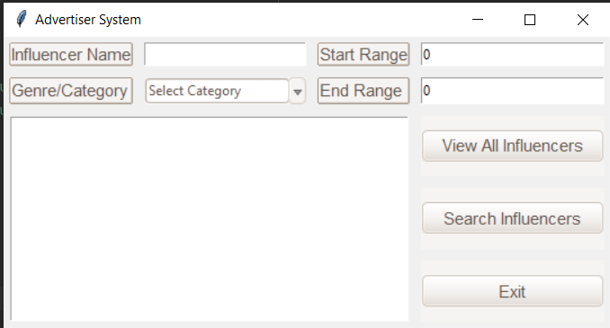

Slide 11
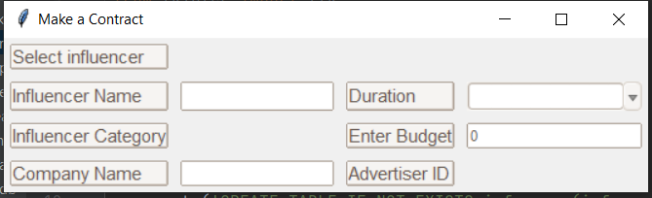

Slide 12
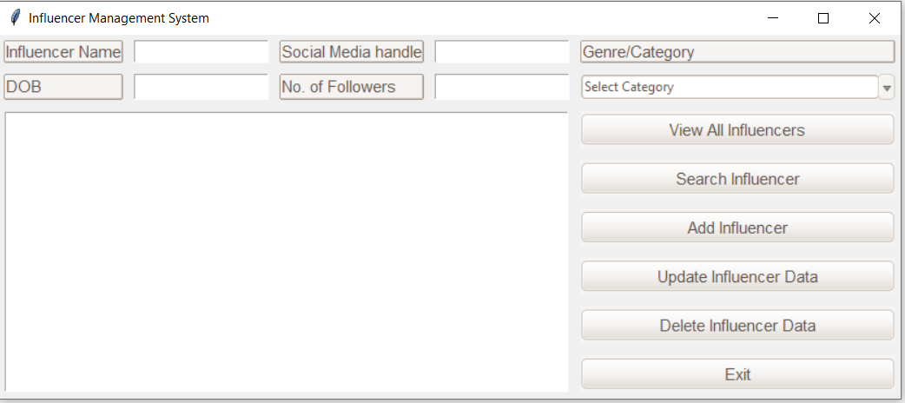

Slide 13

DEMO

Slide 14

Conclusion
With our app we plan on paving ways for influencers to get advertisers and even help small businesses reach out to use influencers and not only big media promoting houses. This app can lay the foundation for building brands and keeps social media apps alive.
With the help of DBMS, we were able to learn ways in which we are able to bring our entrepreneurial apps in fruition

